Slide 1
School of Computing Science and Engineering
Course Code:BTCS2401
Course Name: Computer Graphics
Unit 3
(3D) Three Dimensional
Faculty Name: Mr. Damodharan D
Program Name: B.Tech

Slide 2
Topics to be covered
Unit III:
3-D Viewing
3-D Projections

Slide 3
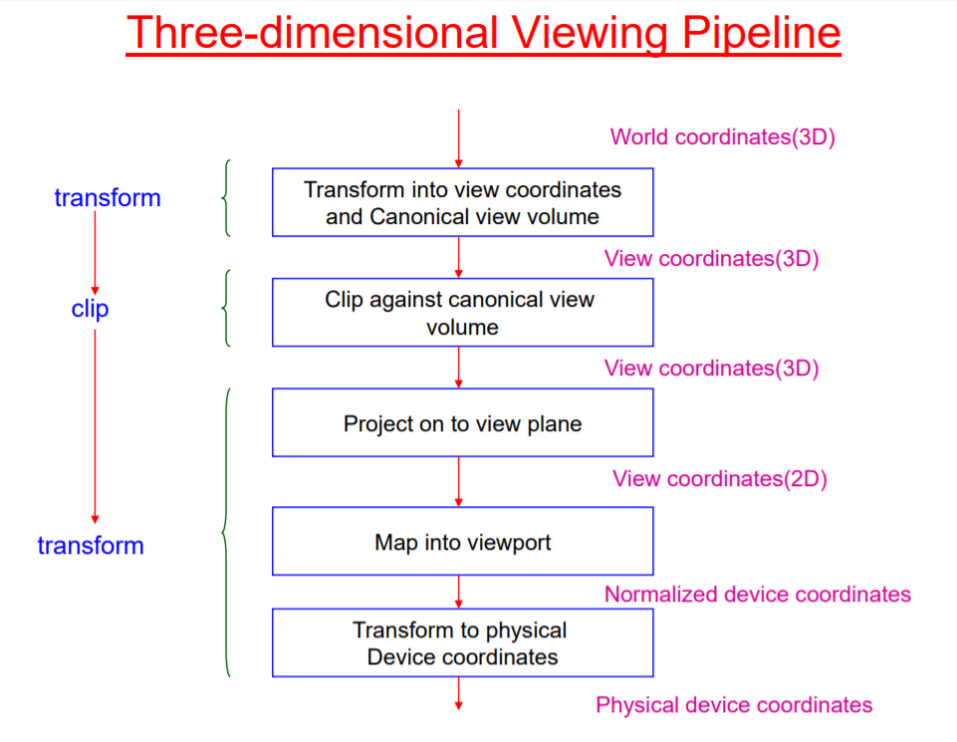
3D Viewing Pipeline

Slide 4
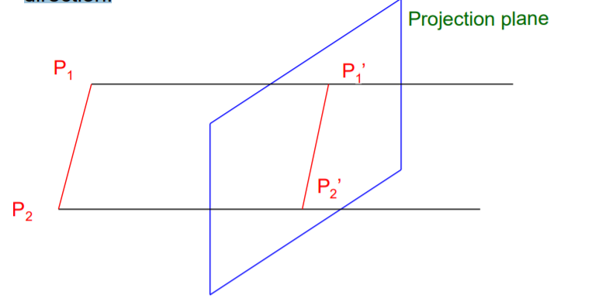
Parallel Projection.
Parallel Projection.
Mostly used by drafters and engineers to create working drawings of an object which preserves its scale and shape.
The distance between the COP and the projection plane is infinite i.e. The projectors are parallel to each other and have a fixed direction.

Slide 5
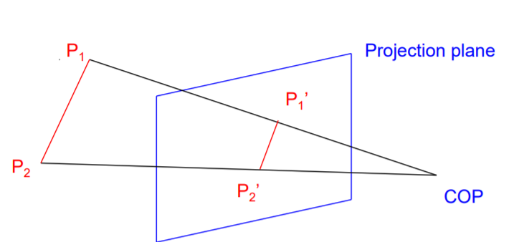
Perspective Projection
Perspective Projection
Generalization of the principles used by artists in drawing of scenes.
It takes object representation in view space (L.H.S.) and produce a projection on the view plane (canvas used by the artist).
The projection of a 3D point onto the view plane is the intersection of the line from the point to the COP (eye position of the artist).
Distance between the COP and projection plane is finite.
Perspective projection does not preserve object scale and shape.

Slide 6
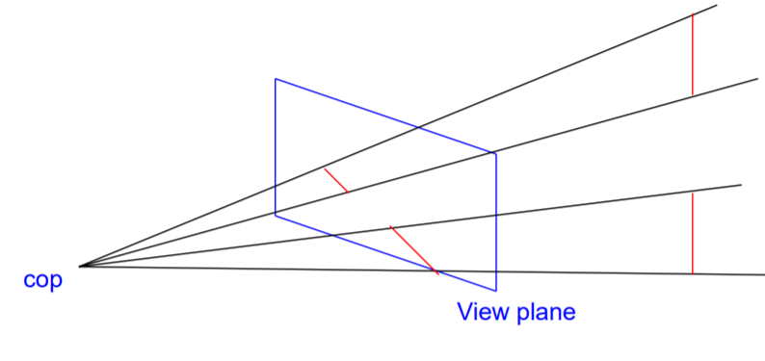
Perspective Anomalies
Perspective Anomalies
Perspective foreshortening
- the out of an object from the COP, the smaller it appears (i.e. its projected size becomes smaller)

Slide 7
Vanishing points
Vanishing points –
There is an illusion that certain sets of parallel lines (that are not parallel to the view plane ) appear to meet at some point on the view plane.
the vanishing point for any set of parallel lines that are parallel to one of principal axis is referred to as a principal vanishing point (PVP).
the number of PVPs is determined by the number of principal axes intersected by the view plane.

Slide 8
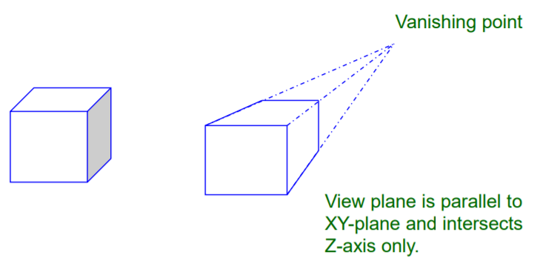
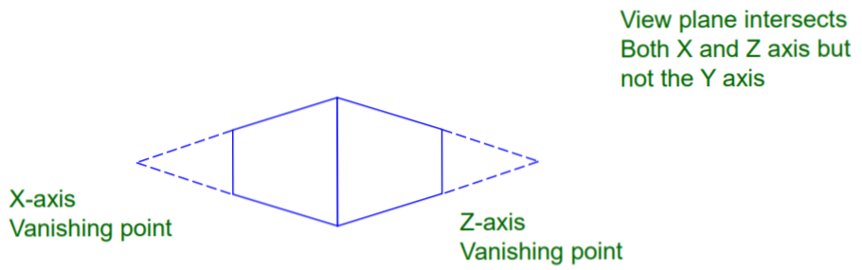
Vanishing points
One principal vanishing point projection
occurs when the projection plane is
perpendicular to one of the principal axes (x, y or z ).
Two principal vanishing point projection.

Slide 9
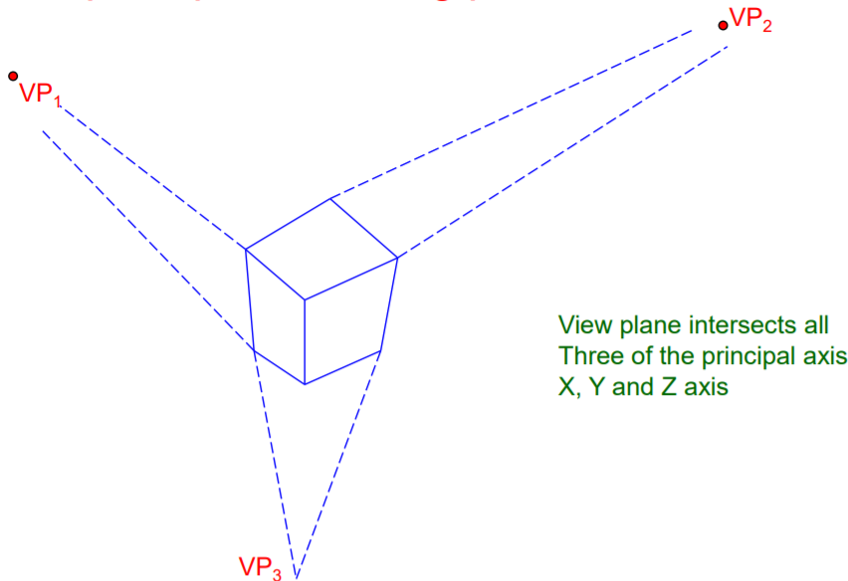
Vanishing points
Three principal vanishing point intersection.

Slide 10
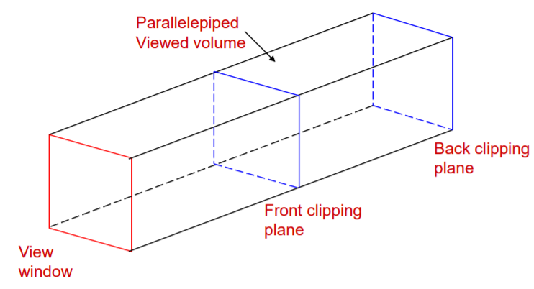
View Volume for Parallel Projection
View Volume for Parallel Projection
-It's shape is an infinite parallelepiped with sides parallel to the direction of projection.
Ref: Computer Graphics‟ by S. Harrington (pp. 279-284)

Slide 11
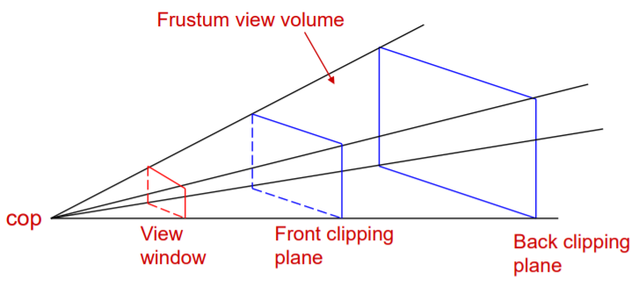
View Volume
View Volume
The view volume bounds that portion of the 3D space that is to be clipped out and projected onto the view plane.
View Volume for Perspective Projection - its shape is semi-infinite pyramid with apex at the view point and edge passing through the corners of the window.

Slide 12
References
Recommended Books
Text books
1. Donald Hearn and M Pauline Baker, “Computer Graphics C Version”, Pearson Education
Reference Books
1. Amrendra N Sinha and Arun D Udai,” Computer Graphics”, TMH16
2. Steven Harrington, “Computer Graphics: A Programming Approach” , TMH
3. Rogers, “ Procedural Elements of Computer Graphics”, McGraw Hill
Additional online materials
https://www.tutorialspoint.com/computer_graphics/
https://www.inf.ed.ac.uk/teaching/courses/cg/index2018.html
https://nptel.ac.in/courses/106106090/

Slide 13
Contact Information
Name : Mr Damodharan D
Email.id: damodharan@galgotiasuniversity.edu.in

Slide 14
GALGOTIAS UNIVERSITY
THANK YOU

